Slide 1


[Category analysis]

Slide 2


Today's agenda
Project recap
Problem
The Analytics team
Process
Insights
Summary

Slide 3

Social buzz is fast growing tech unicorn that need to adapt quickly global scale.
Accenture has begun a 3month POC focusing on these tasks:
- An audit of social buzz’s big data practice
- Recommendations for a successful IPO
- An analysis of their content categories that highlight the
top 5 categories with the largest aggregate popularity
Project Recap

Slide 4

. Every day over 100,000 pieces of content3500
Problem
Every day over 100,000 pieces of content
36500,000 piece of content per year
How to capitalize when there is so much ?
Analyse for social buzz top 5 most popular category of content

Slide 5



chief technical architect
The Analytics team
Senior principal
Data analyst

Slide 6
Process
1
Understanding data
2
Cleaning data
3
Data model
4
Data analysis
5
Uncover insights

Slide 7

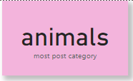
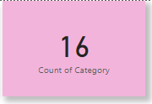
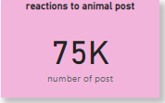

Insights

Slide 8
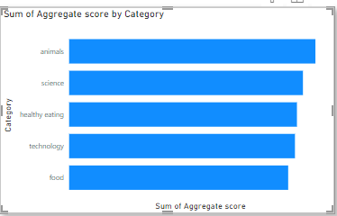
Top 5 categories by aggregate popularity score

Slide 9
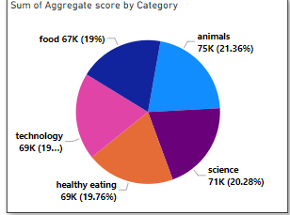
Top 5 most popular categories by percentage -

Slide 10

The project not only successfully extracted valuable insights but also emphasized the importance of data cleaning and integration in ensuring the reliability of analysis outcomes. The top 5 content categories were identified, paving the way for informed decision-making. Moving forward, recommendations and next steps were presented, encouraging ongoing collaboration and strategic planning based on the project's findings. The presentation invites questions and discussion, fostering a dynamic exchange of ideas between the data analyst team and the client.
Summary

Slide 11
Thank you!

